Slide 1
The OnePot PURE cell-free system

Slide 2
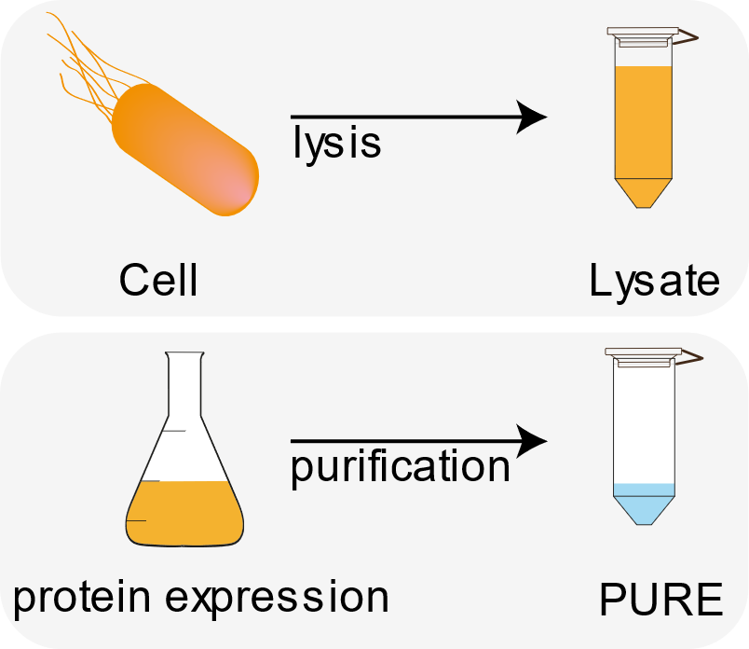
Cell-free systems
Idea: take the cellular transcription / translation out of the cell!

Slide 3



PURE: composition
Proteins
Ribosomes
Energy solution

Slide 4
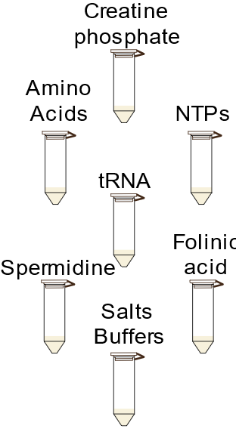
Energy solution
NTPs: ATP, CTP, GTP, TTP: fuels reactions
amino acids: basic building blocks of proteins
tRNA: translation of Codon triplet to amino acid
Energy solution
adapted from: Laohakunakorn et al., Frontiers in Bioengineering and Biotechnology, 2020

Slide 5
Ribosome solution
→ translation
Ribosomes

Slide 6
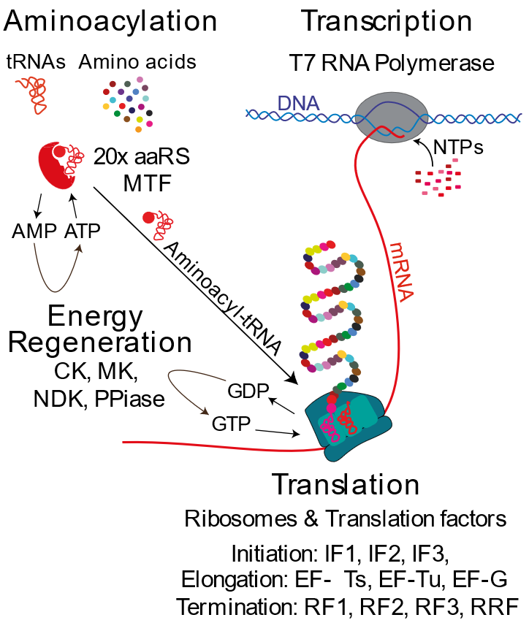
Protein solution
36 proteins that are required for transcription, translation, energy regeneration and aminoacylation (loading of the amino acid onto the tRNA)
Proteins
adapted from: Laohakunakorn et al., Frontiers in Bioengineering and Biotechnology, 2020

Slide 7
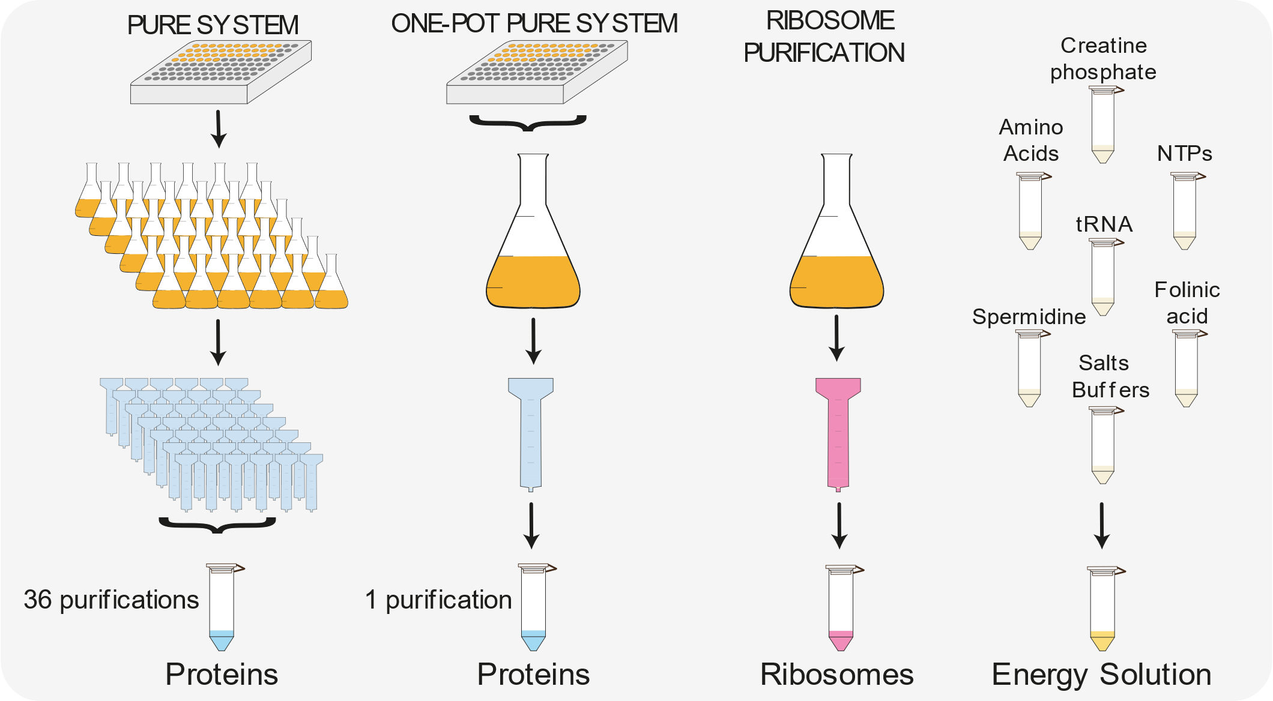
The OnePot method
Introduction and scientific background
adapted from: Laohakunakorn et al., Frontiers in Bioengineering and Biotechnology, 2020
Notes:
protein fraction 36 proteins, ribosomes, energy solution.
20 years, Commercially available
lab: 36 purif cumbersome
OnePot Advantage: Can add things or leave out easily, adjust ratios.

Slide 8
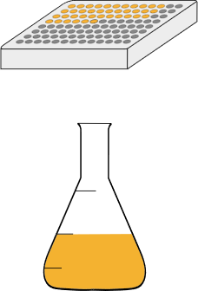
... what we‘re doing today:
Overnight culture
inoculate flask
grow for 2 h
induce protein expression
express for 3 h
harvest

Slide 9
https://www.jove.com/v/62625/onepot-pure-cell-free-system

